Slide 1
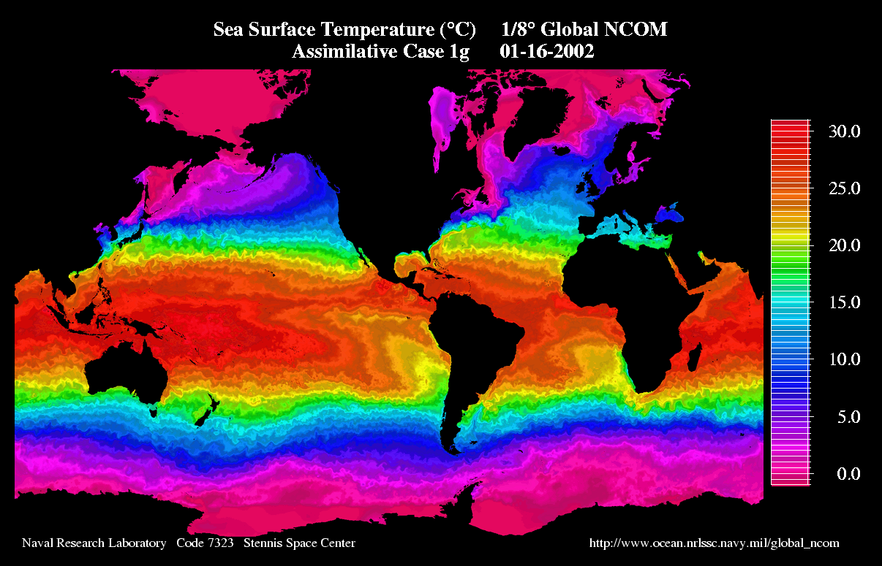

Slide 2
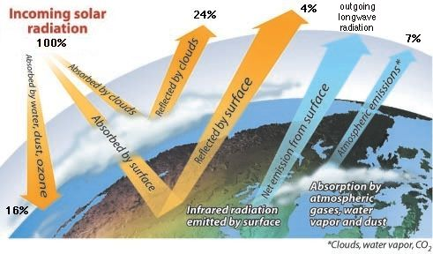
Ocean Heat
Budget

Slide 3
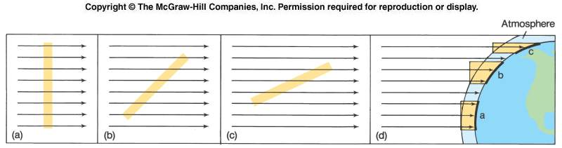
Distribution of Solar Radiation
Solar radiation per unit area (intensity per unit area) is greatest at the equator; least at the poles because of the decreasing angle at which the Sun’s rays strike Earth’s surface and the greater distance the radiation travels through the atmosphere.
The intensity of solar radiation changes with daily and annual cycles - at the equator change in both radiation intensity and length of daylight is minimal. Moving away from the equator in the N and S direction change is greater and greater.

Slide 4
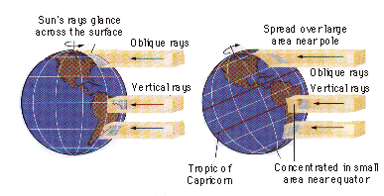
Heat Variations
Latitude
Depends on angle sunlight hits surface
Sunlight at polar latitudes covers wider area; therefore, less heat
At equator, sunlight covers less area; more heat
Mid latitude heating affected by seasons

Slide 5
The Global Energy Budget
•31% of the incoming solar radiation is reflected or scattered back to space – the ALBEDO
•235 Wm⁻² warms the Earth and atmosphere, 168 Wm⁻² of which warms the surface.
•235 Wm⁻² corresponds to a black body temperature of -19 C, thermal emission at 10 um.
•This is colder than Earth’s surface and is reached at around 5 km.
•Thus the peak terrestrial emission is in the atmospheric window in the IR.
•This fraction is transmitted directly to space, but majority is intercepted and interacts.
•Clouds can absorb and emit thermal radiation but are also reflectors of solar radiation and
so act to cool the surface.
•Strong cancellation between these effects the global net effect appears to be a slight
cooling at the surface.
•235 Wm⁻² equates to 120 PW (120 x 1015 W) globally. A 1 % in this value (around 2.5
Wm-2 will dominate over other present man-made energy inputs.

Slide 6
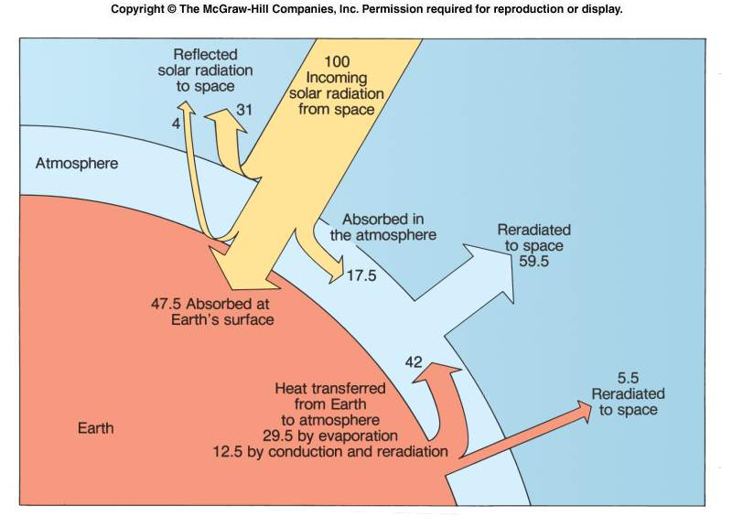
The Heat Budget
To maintain its long-term mean temp of 16ºC Earth re-radiates as much heat back to space as it receives from the Sun. The gains and losses in heat are represented in the heat budget.

Slide 7
Surface Radiation Budget
•Surface rock or soil partly reflects and partly absorbs incoming radiation
•Absorption leads to an increase in surface temperature
•Heat is lost to balance the SW input by LW radiation from the surface and
conduction into the ground and convection in the atmosphere.
•If the surface is damp then evaporation will lead to the removal of heat by
evaporation
•Vegetation uses some of the incoming radiation for photosynthesis
•It has been estimated that around 5% of the incident solar radiation (12% of the
visible radiation) is used in producing biomass.
•The reflected radiation depends strongly on wavelength
•In the near IR leaves may reflect ~40% and absorb 60% of the available sunlight
•However, dense forests absorb 70%, reflect 17% and transmit to the soil 13% of the
available sunlight

Slide 8
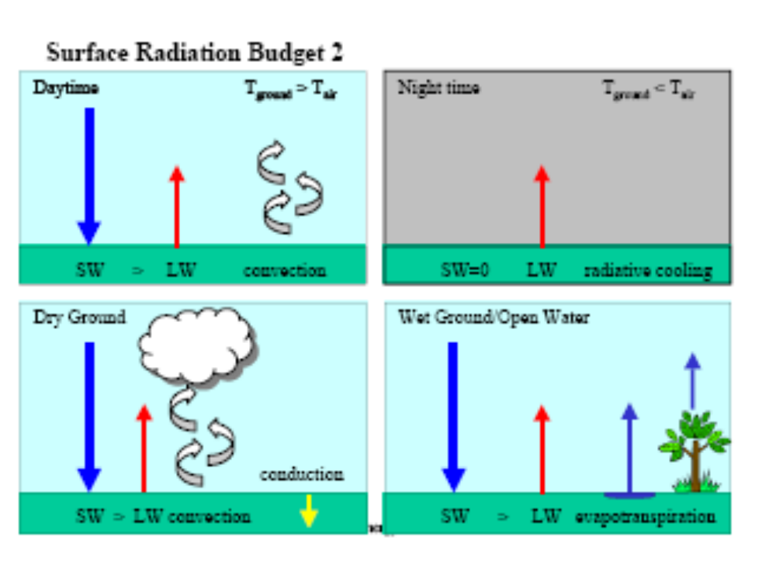

Slide 9
The Heat Budget
To maintain its long-term mean temp of 16ºC Earth reradiates as much heat back to space as it receives from the Sun. The gains and losses in heat are represented in the heat budget.

Slide 10
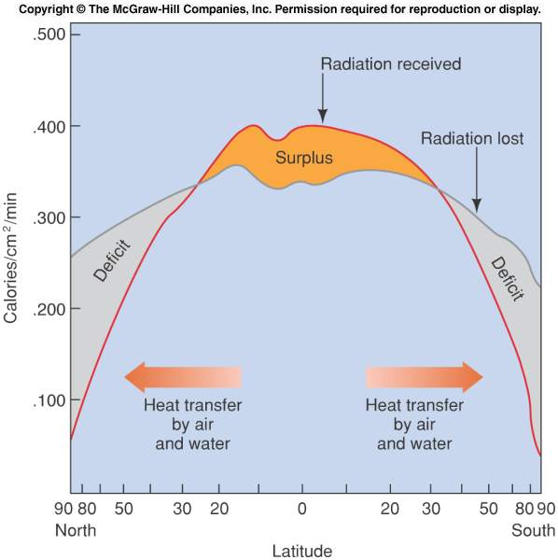
Comparison of incoming and outgoing radiation with latitude. A transfer of energy is needed to maintain a balance.
- At higher latitudes more energy is lost to space than is received at the surface.
- At lower latitudes each unit of surface area absorbs more radiant energy annually than it loses to space - surplus.
-This surplus of energy at low latitudes sets the atmosphere and oceans in motion and heat is transferred poleward by winds and ocean currents.

Slide 11
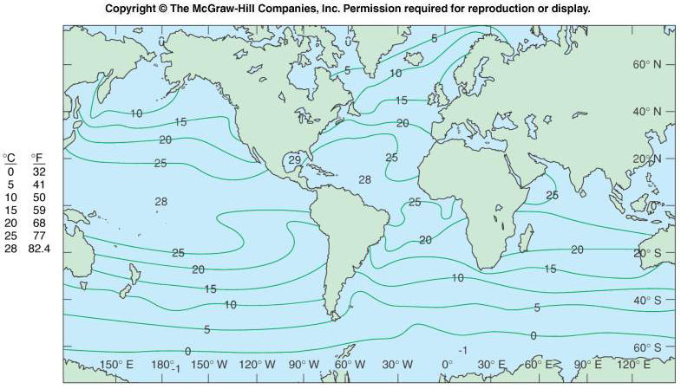
Typical average sea temperatures during the Northern Hemisphere summer. At each latitude the annual temperature changes are controlled by changes in available solar radiation and heat loss combined with the heat capacity of the surface material.

Slide 12
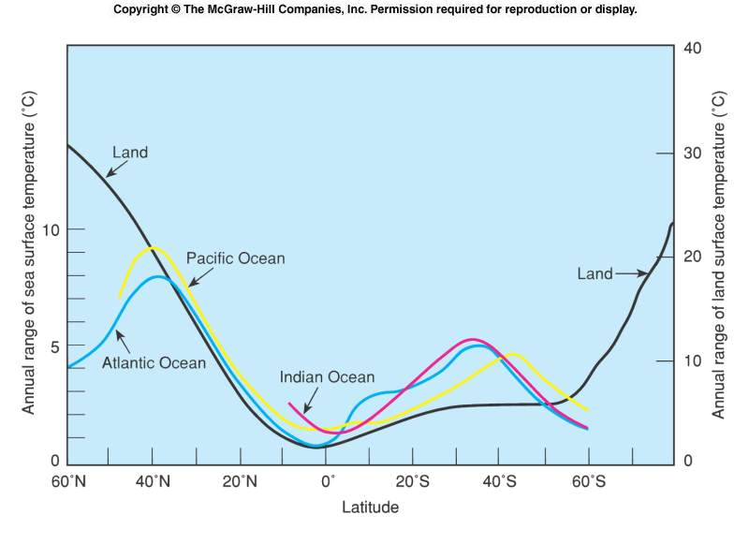
The annual range of mid-ocean sea surface temperatures is considerably less than the annual range of land surface temperatures at the higher latitudes. The maximum annual range of sea surface temperatures occurs at the middle latitudes.
Heat capacity affects land and sea differently.

Slide 13
Variations in the Heat Budget Across the Globe
There is an excess of incoming shortwave radiation between 35 °S and 40 °N and a deficit at higher latitudes compared with the outgoing longwave radiation budget.
If equilibrium were to be maintained at every latitude the short and longwave
radiation should balance locally.
The fact that they are not, and as local mean temperatures close to the equator are not increasing with time and those close to the poles are not decreasing, heat energy must be transported from low latitudes poleward.
This is achieved by circulation within both the ocean and the atmosphere,
transporting heat away from the equator towards the pole and maintaining a higher temperature at latitudes greater than 50° than would be possible from a system in radiative equilibrium, illustrated by the thin broken curve in the previous figure

Slide 14
The oceanic heat budget consists of inputs (+) and outputs (-).
Primary inputs and outputs
radiation from the sun (+)
long-wave back radiation (-)
direct heat transfer air/water (transfer of sensible heat) (-; + when from air to water)
evaporative heat transfer (-; + when condensation; this situation occurs very rarely, mainly during sea fog conditions)
advective heat transfer (currents, vertical convection, turbulence) (- or +); this effect cancels on the global scale or in closed basins

Slide 15
Secondary sources
heat gain from chemical/biological processes (+)
heat gain from the earth's interior and hydrothermal activity(+)
heat gain from current friction (+)
heat gain from radioactivity (+)
The contributions from secondary sources are negligible for most applications.

Slide 16
Not all of the radiation received at the outer atmosphere is available to the ocean
16% are absorbed in the atmosphere
24% are reflected by clouds
7% are radiated back to space from the atmosphere
4% are reflected from the earth's surface (mainly from the sea)

Slide 17
Thus, 35% returns into space, while 65% are available as energy.

Slide 18
Heat Budget Outputs
Back Radiation
Some of the radiation received from the sun is radiated back from the ocean surface
Direct (Sensible) Heat Transfer Between Ocean and Atmosphere
On average, the ocean surface is about 0.8°C warmer than the air above it. Direct heat transfer (transfer of sensible heat) therefore occurs usually from water to air and constitutes a heat loss.

Slide 19
Evaporative Heat Transfer
51% of the heat input into the ocean is used for evaporation.

Slide 20
The heat budget is the balance
net radiative heat gain - evaporative heat loss - direct heat loss = 0

Slide 21
Net heat input decreases from the tropics towards the poles; it has a weak minimum near the equator because of heavy cloud cover in that region.
Maximum evaporative heat loss in the subtropics is produced by atmospheric advection of dry air;
Minimum in the tropics results from high moisture content of the tropical air.
Currents remove heat from the tropics (this is a heat loss to the ocean - positive values) and deposit it in the subpolar regions ( a heat gain - negative values).

Slide 22
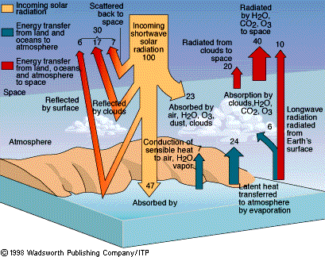
Heat Budget
Heat input = Heat output
100 units = 30 units + 70 units
(from sun)
(Reflected)
(heat Earth)
70 units = 47 units + 23 units
(absorbed by surface)
(by atmosphere)

Slide 23
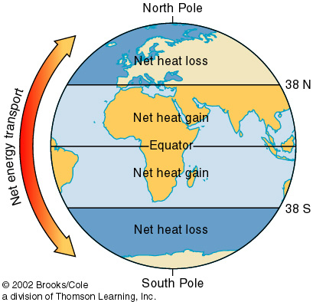
Heat Transfer
Heat is transferred from equator to poles
Air Circulation
Ocean currents

Slide 24
Heat Storage
•Absorbed radiative energy in the atmosphere is transformed into sensible and latent energy. •Over land this manifests as increases in temperature and/or evaporation, the partitioning depends on available moisture and the ground vegetation cover. •In the tropics in summer the land warms relative to the ocean and hence develops monsoon systems. •Water is evaporated from the ocean surface, cooling the ocean. •As water vapour and thus latent energy it can be transported considerable distance before removal by precipitation, provided an efficient heat transport mechanism. • Increases in temperature cause an increase in the internal energy of the atmosphere, casuing it to expand, changing its altitude and hence potential energy.
The combination of internal and potential energy can be expressed as enthalpy or sensible heat.

Slide 25
Heat Transfer in the Ocean and Atmosphere
•Much of the heat transport polewards takes place by atmospheric circulation. •However, a significant fraction, especially near the equator, the Hadley Cell only weakly transfers heat polewards, takes place through thesurface waters of the ocean.•The ocean surface heat transport is largely by wind blowing across the sea surface driving surface water currents •The oceans are capable of storing heat for a wide range of time scales and subsequently transporting it to other locations. •The thermohaline circulation can store heat for 1000s of years.
•The strongest thermohaline circulation is in the Atlantic Ocean, whereas the Pacific Ocean is much fresher and features shallower circulations. •This is largely due to differences in salinity. The atmosphere transports water
vapour across the isthmus in central America from the Atlantic to the Pacific, leaving the former saltier than the latter.

Slide 26



